Slide 1
.NET 8 & React Tutorial
Prepared by: Ahmad Faeez Azhari

Slide 2
SETUP CONNECTION FOR BOTH BACKEND AND FRONTEND

Slide 3
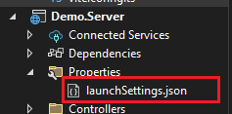
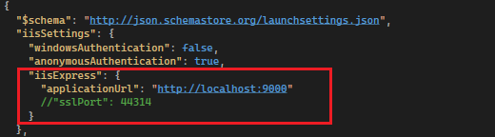
SETUP PORT IN LOCAL
.Server (.NET)
Navigate to launchSettings.json to change port.
Find iisSettings setup, and change the port based on available port in local. Comment sslPort if you want to disable the (https), otherwise the application will run in https by default.

Slide 4
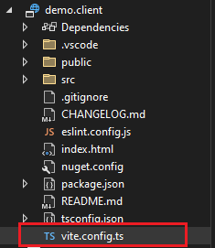
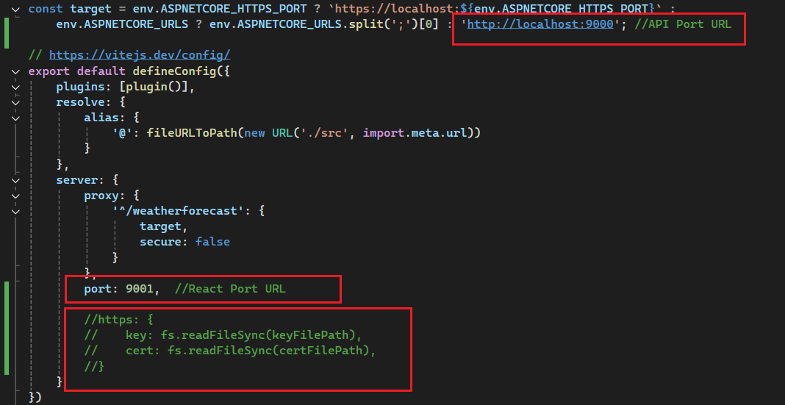
SETUP PORT IN LOCAL
.client (React)
Navigate to vite.config.ts / vite.config.js to change port.
Change target link from https to http and set the port to the .Server (.net) API.
Port for default defineConfig can be change accordingly, this port specifically for React and comment https setting

Slide 5
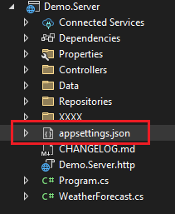
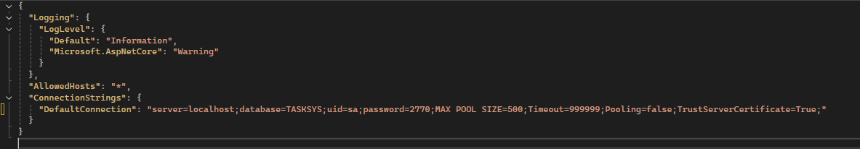
SETUP DATABASE
.Server (.NET)
Navigate to appsettings.json to insert database connection.
Add your database connection accordingly.
Notes:
{
"Logging": {
"LogLevel": {
"Default": "Information",
"Microsoft.AspNetCore": "Warning"
}
},
"AllowedHosts": "*",
"ConnectionStrings": {
"DefaultConnection": "server=localhost;database=TASKSYS;uid=sa;password=2770;MAX POOL SIZE=500;Timeout=999999;Pooling=false;TrustServerCertificate=True;"
}
}

Slide 6
CREATING API

Slide 7
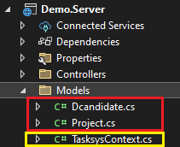
CREATING API
Generate from an Existing Database (Database-First Approach)
If you already have a SQL Server database, you can generate entity models automatically using Entity Framework Core scaffolding.
Please install this tools before run the command below
dotnet ef –version
dotnet tool install --global dotnet-ef
dotnet tool update --global dotnet-ef
Run This Command to Auto-Generate Models
dotnet ef dbcontext scaffold "server=localhost;database=TASKSYS;uid=sa;password=2770;MAX POOL SIZE=500;Timeout=999999;Pooling=false;TrustServerCertificate=True;" Microsoft.EntityFrameworkCore.SqlServer -o Models
Notes:
dotnet ef dbcontext scaffold "server=localhost;database=TASKSYS;uid=sa;password=2770;MAX POOL SIZE=500;Timeout=999999;Pooling=false;TrustServerCertificate=True;" Microsoft.EntityFrameworkCore.SqlServer -o Models

Slide 8
CREATING API
If you have changes in database and you want to migrate it into your models, add keywords ‘—force’
dotnet ef dbcontext scaffold "server=localhost;database=TASKSYS;uid=sa;password=2770;MAX POOL SIZE=500;Timeout=999999;Pooling=false;TrustServerCertificate=True;" Microsoft.EntityFrameworkCore.SqlServer -o Models --force
Then, the system will auto generate models for each table.
Red box: Each model generated from each table in database.
Yellow box: Database context which manages database operations in .NET.
To find context file, “DBNameContext.cs”
Notes:
dotnet ef dbcontext scaffold "server=localhost;database=TASKSYS;uid=sa;password=2770;MAX POOL SIZE=500;Timeout=999999;Pooling=false;TrustServerCertificate=True;" Microsoft.EntityFrameworkCore.SqlServer -o Models

Slide 9
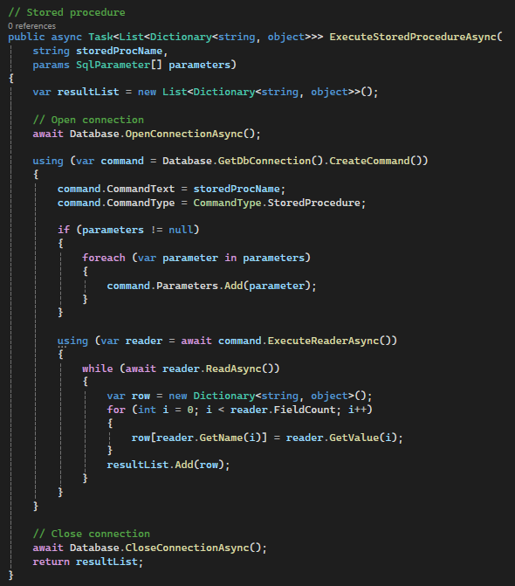
CREATING API
To implement Stored Procedure, add additional code in the Context file.
Notes:
// Stored procedure
public async Task<List<Dictionary<string, object>>> ExecuteStoredProcedureAsync(
string storedProcName,
params SqlParameter[] parameters)
{
var resultList = new List<Dictionary<string, object>>();
// Open connection
await Database.OpenConnectionAsync();
using (var command = Database.GetDbConnection().CreateCommand())
{
command.CommandText = storedProcName;
command.CommandType = CommandType.StoredProcedure;
if (parameters != null)
{
foreach (var parameter in parameters)
{
command.Parameters.Add(parameter);
}
}
using (var reader = await command.ExecuteReaderAsync())
{
while (await reader.ReadAsync())
{
var row = new Dictionary<string, object>();
for (int i = 0; i < reader.FieldCount; i++)
{
row[reader.GetName(i)] = reader.GetValue(i);
}
resultList.Add(row);
}
}
}
// Close connection
await Database.CloseConnectionAsync();
return resultList;
}

Slide 10
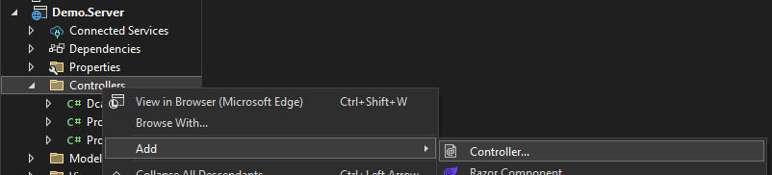
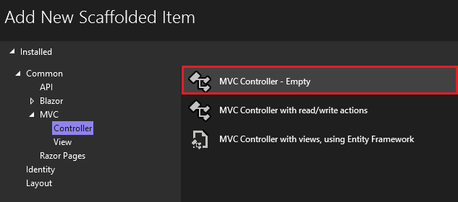
CREATING API
Create controller for each model. Right click on the controllers folder, choose Add new Controller. Controllers > Add > Controller. Select ‘MVC Controller – Empty’ and name the controller based on your models. For example: ProjectController.cs

Slide 11
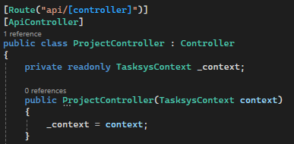
CREATING API USING EF CORE
Defines the base route for the controller.
[controller] is replaced by Project (model), making the API endpoint:
api/Project
TasksysContext _context; → Dependency Injection for database access
public ProjectController(TasksysContext context) { _context = context; }
Ensures connection with the database
Notes:
using Microsoft.AspNetCore.Mvc;
using Microsoft.EntityFrameworkCore;
using Demo.Server.Models;
namespace Demo.Server.Controllers
{
[Route("api/[controller]")]
[ApiController]
public class ProjectController : Controller
{
private readonly TasksysContext _context;
public ProjectController(TasksysContext context)
{
_context = context;
}

Slide 12
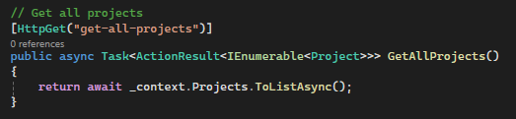
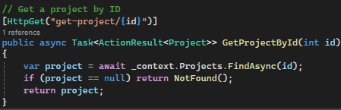
CREATING API USING EF CORE
Retrieving All Projects (GET-ALL)
Get All Projects
Explanation:
Uses HttpGet to fetch all projects
Returns a list of projects asynchronously
Retrieving a Project by ID (GET-BYID)
Get Project by ID
Explanation:
Fetches a project by ID
Returns 404 Not Found if the project does not exist
Notes:
// Get all projects
[HttpGet("get-all-projects")]
public async Task<ActionResult<IEnumerable<Project>>> GetAllProjects()
{
return await _context.Projects.ToListAsync();
}
// Get a project by ID
[HttpGet("get-project/{id}")]
public async Task<ActionResult<Project>> GetProjectById(int id)
{
var project = await _context.Projects.FindAsync(id);
if (project == null) return NotFound();
return project;
}

Slide 13
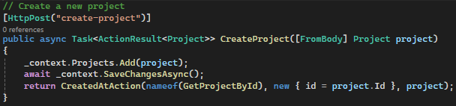
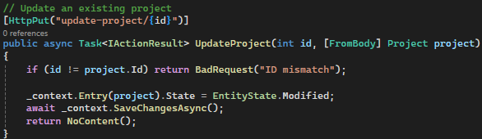
CREATING API USING EF CORE
Creating a Project (CREATE)
Create a New Project
Explanation:
Uses HttpPost to add a new project. Saves changes asynchronously
Returns the created project with a 201 Created response
Updating a Project (UPDATE)
Update an Existing Project
Explanation:
Uses HttpPut to update project details
Checks for ID mismatch before updating
Returns 204 No Content on success
Notes:
// Create a new project
[HttpPost("create-project")]
public async Task<ActionResult<Project>> CreateProject([FromBody] Project project)
{
_context.Projects.Add(project);
await _context.SaveChangesAsync();
return CreatedAtAction(nameof(GetProjectById), new { id = project.Id }, project);
}
// Update an existing project
[HttpPut("update-project/{id}")]
public async Task<IActionResult> UpdateProject(int id, [FromBody] Project project)
{
if (id != project.Id) return BadRequest("ID mismatch");
_context.Entry(project).State = EntityState.Modified;
await _context.SaveChangesAsync();
return NoContent();
}

Slide 14
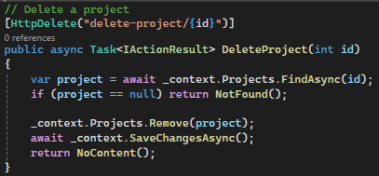
CREATING API USING EF CORE
Deleting a Project (DELETE)
Delete a Project
Explanation:
Uses HttpDelete to remove a project
Returns 404 Not Found if project doesn’t exist
Deletes the project and returns 204 No Content
Notes:
// Delete a project
[HttpDelete("delete-project/{id}")]
public async Task<IActionResult> DeleteProject(int id)
{
var project = await _context.Projects.FindAsync(id);
if (project == null) return NotFound();
_context.Projects.Remove(project);
await _context.SaveChangesAsync();
return NoContent();
}

Slide 15
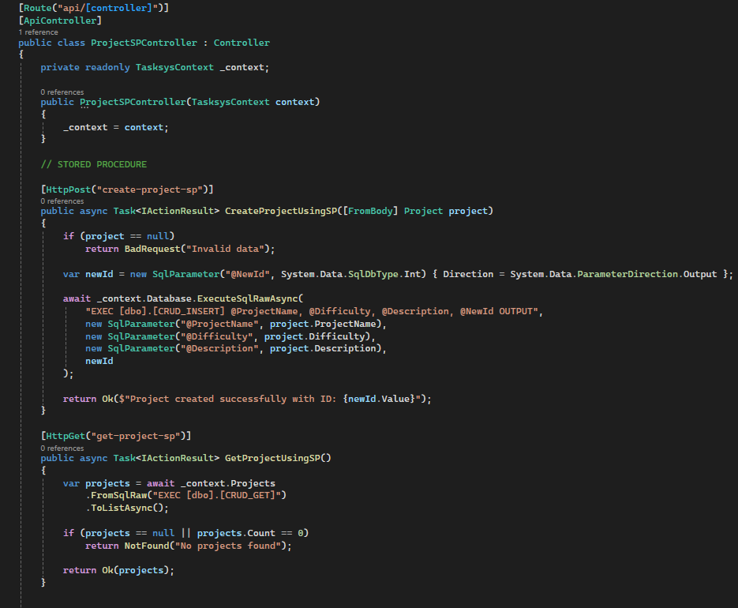
CREATING API USING STORED PROCEDURE
Creating API using Stored Procedure same with the EF Core structure, the different is inside the code, need to include:- await _context.Database.ExecuteSqlRawAsync
Process of creating Stored Procedure in SQL is the same with the current method. Ensure create it inside the Database.
Notes:
using Demo.Server.Models;
using Microsoft.AspNetCore.Mvc;
using Microsoft.Data.SqlClient;
using Microsoft.EntityFrameworkCore;
namespace Demo.Server.Controllers
{
[Route("api/[controller]")]
[ApiController]
public class ProjectSPController : Controller
{
private readonly TasksysContext _context;
public ProjectSPController(TasksysContext context)
{
_context = context;
}
// STORED PROCEDURE
[HttpPost("create-project-sp")]
public async Task<IActionResult> CreateProjectUsingSP([FromBody] Project project)
{
if (project == null)
return BadRequest("Invalid data");
var newId = new SqlParameter("@NewId", System.Data.SqlDbType.Int) { Direction = System.Data.ParameterDirection.Output };
await _context.Database.ExecuteSqlRawAsync(
"EXEC [dbo].[CRUD_INSERT] @ProjectName, @Difficulty, @Description, @NewId OUTPUT",
new SqlParameter("@ProjectName", project.ProjectName),
new SqlParameter("@Difficulty", project.Difficulty),
new SqlParameter("@Description", project.Description),
newId
);
return Ok($"Project created successfully with ID: {newId.Value}");
}
[HttpGet("get-project-sp")]
public async Task<IActionResult> GetProjectUsingSP()
{
var projects = await _context.Projects
.FromSqlRaw("EXEC [dbo].[CRUD_GET]")
.ToListAsync();
if (projects == null || projects.Count == 0)
return NotFound("No projects found");
return Ok(projects);
}
[HttpPut("update-project-sp")]
public async Task<IActionResult> UpdateProjectUsingSP([FromBody] Project project)
{
if (project == null)
return BadRequest("Invalid data");
var result = await _context.Database.ExecuteSqlRawAsync(
"EXEC [dbo].[CRUD_UPDATE] @Id, @ProjectName, @Difficulty, @Description",
new SqlParameter("@Id", project.Id),
new SqlParameter("@ProjectName", project.ProjectName),
new SqlParameter("@Difficulty", project.Difficulty),
new SqlParameter("@Description", project.Description)
);
if (result == 0)
return NotFound("Project not found or update failed");
return Ok("Project updated successfully using stored procedure");
}
[HttpDelete("delete-project-sp/{id}")]
public async Task<IActionResult> DeleteProjectUsingSP(int id)
{
var result = await _context.Database.ExecuteSqlRawAsync(
"EXEC [dbo].[CRUD_DELETE] @Id",
new SqlParameter("@Id", id)
);
if (result == 0)
return NotFound("Project not found or delete failed");
return Ok("Project deleted successfully using stored procedure");
}
}
}

Slide 16
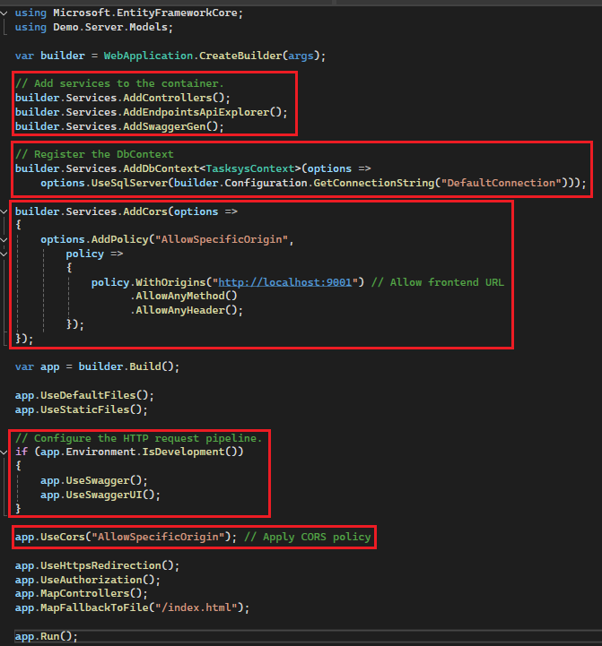
CREATING API USING STORED PROCEDURE
Before we run the application, ensure database connection register in the Program.cs
Add services to the container.
Add CORS policy and allow it in order to .NET (API) can interact with frontend port (React).
In order to run the Swagger UI to test specific API , ensure these settings are enable (make sure only run during development):
UseSwagger()
UseSwaggerUI()
Notes:
using Microsoft.EntityFrameworkCore;
using Demo.Server.Models;
var builder = WebApplication.CreateBuilder(args);
// Add services to the container.
builder.Services.AddControllers();
builder.Services.AddEndpointsApiExplorer();
builder.Services.AddSwaggerGen();
// Register the DbContext
builder.Services.AddDbContext<TasksysContext>(options =>
options.UseSqlServer(builder.Configuration.GetConnectionString("DefaultConnection")));
builder.Services.AddCors(options =>
{
options.AddPolicy("AllowSpecificOrigin",
policy =>
{
policy.WithOrigins("http://localhost:9001") // Allow frontend URL
.AllowAnyMethod()
.AllowAnyHeader();
});
});
var app = builder.Build();
app.UseDefaultFiles();
app.UseStaticFiles();
// Configure the HTTP request pipeline.
if (app.Environment.IsDevelopment())
{
app.UseSwagger();
app.UseSwaggerUI();
}
app.UseCors("AllowSpecificOrigin"); // Apply CORS policy
app.UseHttpsRedirection();
app.UseAuthorization();
app.MapControllers();
app.MapFallbackToFile("/index.html");
app.Run();

Slide 17
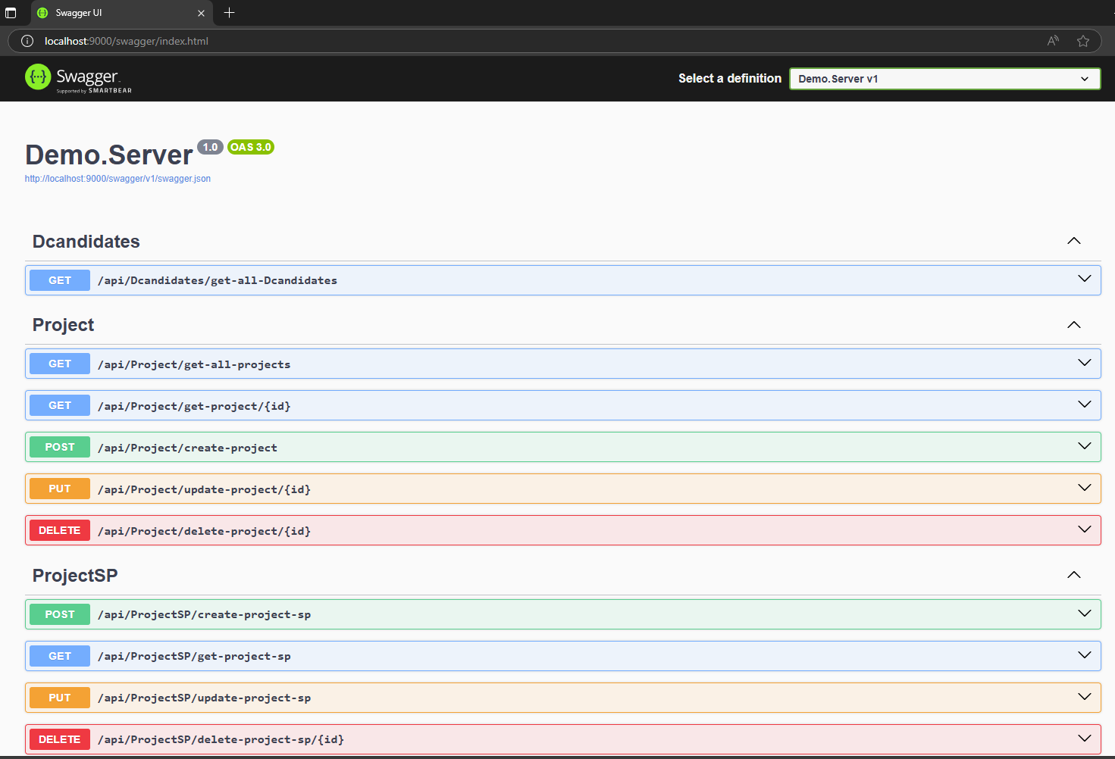
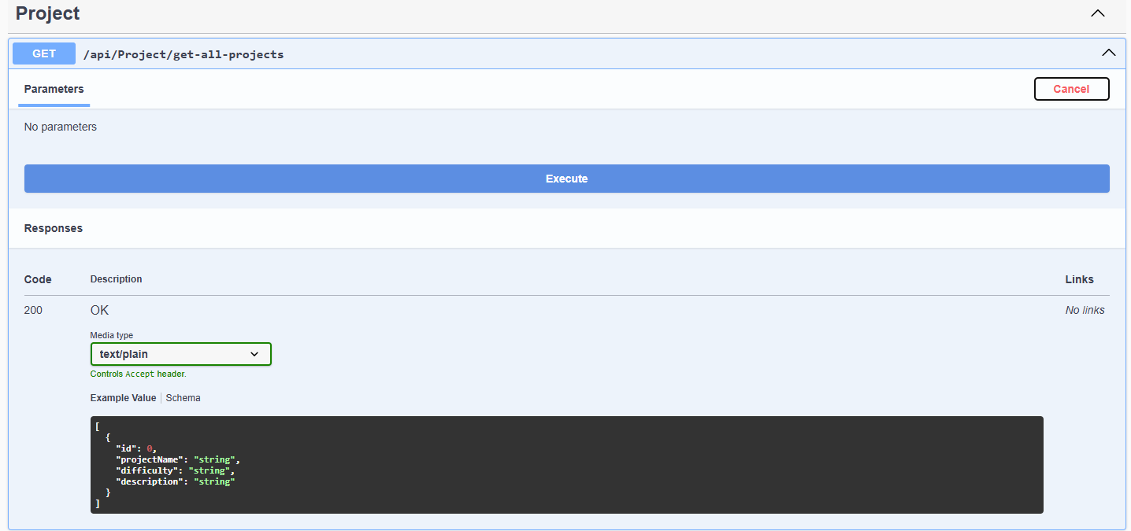
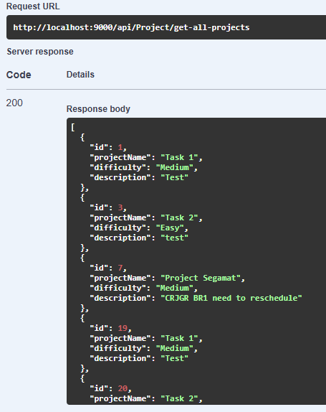
TEST API IN SWAGGER UI
Run the application using IIS Express. Make sure .Server already set as startup project.
Swagger UI page contains all API that has been declared.
The name of each API such as api/Project/get-all-projects is the URL will be use to call in frontend (React).
Test each API by execute selected API to get the string of data.
Response body will be provided under the Request URL

Slide 18
CREATING FRONTEND REACT

Slide 19
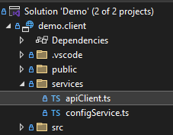

REACT TO AUTO GENERATE DTOS
Auto generate apiClient.ts file
npx nswag openapi2tsclient /input:http://localhost:9000/swagger/v1/swagger.json /output:services/apiClient.ts
DTOs (Data Transfer Objects) are objects used to transfer data between different layers of an application, such as between the backend (API) and frontend, or between services.
Why Use DTOs?
Encapsulation – Only expose necessary data, keeping internal structures hidden.
Performance – Reduce unnecessary data transfer by only including required fields.
Security – Prevent exposing sensitive database structures directly.
Decoupling – Separate domain models from API contracts, making maintenance easier.
Notes:
npx nswag openapi2tsclient /input:http://localhost:9000/swagger/v1/swagger.json /output:services/apiClient.ts

Slide 20
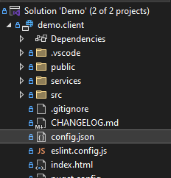
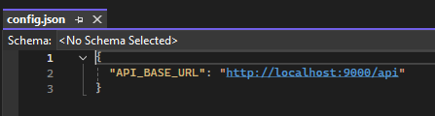
ADD CONFIG FILE
Add file named ‘config.json’
Insert "API_BASE_URL": "http://localhost:9000/api"
Notes:
"API_BASE_URL": "http://localhost:9000/api"

Slide 21
UNDERSTANDING COMPONENTS REACT
Functional vs Class Components
Props and State in React
Example of a functional component:
const Welcome = (props) => {
return <h1>Hello, {props.name}!</h1>;
};
useState Hook
useState for managing component state
Example:
import { useState } from 'react';
const Counter = () => {
const [count, setCount] = useState(0);
return (
<button onClick={() => setCount(count + 1)}>Count: {count}</button>
);
};

Slide 22
UNDERSTANDING COMPONENTS REACT
useEffect Hook for Side Effects
Used for fetching data, updating DOM, etc.
Example:
import { useEffect, useState } from 'react';
const DataFetcher = () => {
const [data, setData] = useState([]);
useEffect(() => {
fetch('/api/data').then(response => response.json()).then(setData);
}, []);
return <div>{JSON.stringify(data)}</div>;
};

Slide 23
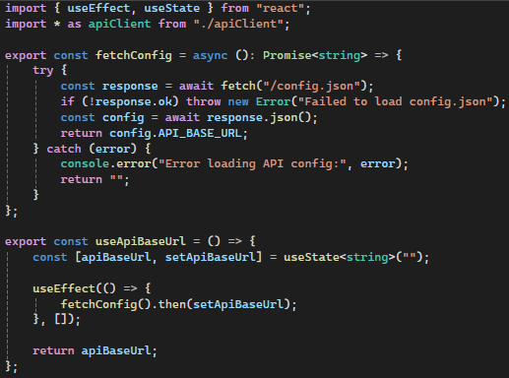
READ FILE CONFIG.JSON IN REACT
Configuration Handling (`useApiBaseUrl`)
Loads `API_BASE_URL` from `config.json` asynchronously.
Uses `useEffect` and `useState` to store and update the API base URL.
Helps centralize API endpoint management.
Notes:
import { useEffect, useState } from "react";
import * as apiClient from "./apiClient";
export const fetchConfig = async (): Promise<string> => {
try {
const response = await fetch("/config.json");
if (!response.ok) throw new Error("Failed to load config.json");
const config = await response.json();
return config.API_BASE_URL;
} catch (error) {
console.error("Error loading API config:", error);
return "";
}
};
export const useApiBaseUrl = () => {
const [apiBaseUrl, setApiBaseUrl] = useState<string>("");
useEffect(() => {
fetchConfig().then(setApiBaseUrl);
}, []);
return apiBaseUrl;
};

Slide 24
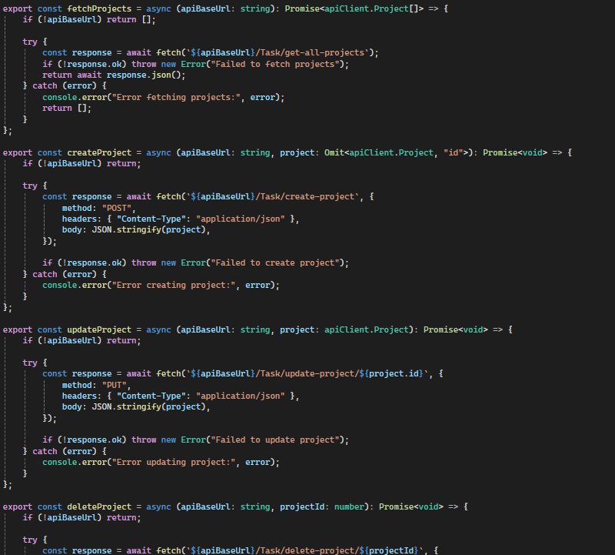
FETCH DATA FROM API
API Request Functions
`fetchProjects(apiBaseUrl)`: Fetches all projects.
`createProject(apiBaseUrl, project)`: Adds a new project.
`updateProject(apiBaseUrl, project)`: Updates an existing project.
`deleteProject(apiBaseUrl, projectId)`: Deletes a project.
Uses async/await and `fetch` for API requests.
Ensures all API calls handle errors gracefully with `try-catch`.
Uses `fetch` with async/await for cleaner asynchronous code.
Notes:
export const fetchProjects = async (apiBaseUrl: string): Promise<apiClient.Project[]> => {
if (!apiBaseUrl) return [];
try {
const response = await fetch(`${apiBaseUrl}/Task/get-all-projects`);
if (!response.ok) throw new Error("Failed to fetch projects");
return await response.json();
} catch (error) {
console.error("Error fetching projects:", error);
return [];
}
};
export const createProject = async (apiBaseUrl: string, project: Omit<apiClient.Project, "id">): Promise<void> => {
if (!apiBaseUrl) return;
try {
const response = await fetch(`${apiBaseUrl}/Task/create-project`, {
method: "POST",
headers: { "Content-Type": "application/json" },
body: JSON.stringify(project),
});
if (!response.ok) throw new Error("Failed to create project");
} catch (error) {
console.error("Error creating project:", error);
}
};
export const updateProject = async (apiBaseUrl: string, project: apiClient.Project): Promise<void> => {
if (!apiBaseUrl) return;
try {
const response = await fetch(`${apiBaseUrl}/Task/update-project/${project.id}`, {
method: "PUT",
headers: { "Content-Type": "application/json" },
body: JSON.stringify(project),
});
if (!response.ok) throw new Error("Failed to update project");
} catch (error) {
console.error("Error updating project:", error);
}
};
export const deleteProject = async (apiBaseUrl: string, projectId: number): Promise<void> => {
if (!apiBaseUrl) return;
try {
const response = await fetch(`${apiBaseUrl}/Task/delete-project/${projectId}`, {
method: "DELETE",
});
if (!response.ok) throw new Error("Failed to delete project");
} catch (error) {
console.error("Error deleting project:", error);
}
};

Slide 25
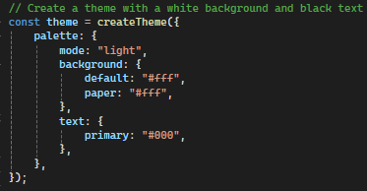
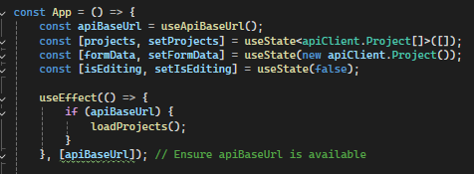
APPLICATION IN REACT
Theming support with MUI ThemeProvider
Uses MUI's createTheme() for a light mode theme
useState to manage projects and form data
useEffect to fetch projects when API base URL is available
API calls update state dynamically
Fetching & Managing Projects
Fetch projects from API on load.
handleSubmit(): Creates or updates a project
handleEdit(): Loads project data into the form
handleDelete(): Deletes a project from API
Notes:
import { useEffect, useState } from "react";
import { Container, TextField, Button, Table, TableBody, TableCell, TableContainer, TableHead, TableRow, Paper, IconButton, CssBaseline, ThemeProvider, createTheme, Stack } from "@mui/material";
import { Edit, Delete } from "@mui/icons-material";
import * as apiClient from "../services/apiClient";
import { useApiBaseUrl, fetchProjects, createProject, updateProject, deleteProject } from "../services/configService";
// Create a theme with a white background and black text
const theme = createTheme({
palette: {
mode: "light",
background: {
default: "#fff",
paper: "#fff",
},
text: {
primary: "#000",
},
},
});
const App = () => {
const apiBaseUrl = useApiBaseUrl();
const [projects, setProjects] = useState<apiClient.Project[]>([]);
const [formData, setFormData] = useState(new apiClient.Project());
const [isEditing, setIsEditing] = useState(false);
useEffect(() => {
if (apiBaseUrl) {
loadProjects();
}
}, [apiBaseUrl]); // Ensure apiBaseUrl is available
const loadProjects = async () => {
const data = await fetchProjects(apiBaseUrl);
setProjects(data);
};
const handleChange = (e: React.ChangeEvent<HTMLInputElement>) => {
setFormData((prev) => Object.assign(new apiClient.Project(), prev, { [e.target.name]: e.target.value }));
};
const handleSubmit = async (e: React.FormEvent) => {
e.preventDefault();
if (isEditing) {
await updateProject(apiBaseUrl, formData);
} else {
const newProject = Object.assign(new apiClient.Project(), formData);
newProject.id = undefined; // Ensure ID is not sent for creation
await createProject(apiBaseUrl, newProject);
}
setFormData(new apiClient.Project()); // Reset form using a new instance
setIsEditing(false);
loadProjects();
};
const handleEdit = (project: apiClient.Project) => {
setFormData(Object.assign(new apiClient.Project(), project));
setIsEditing(true);
};
const handleDelete = async (id?: number) => {
if (id !== undefined) {
await deleteProject(apiBaseUrl, id);
loadProjects();
}
};
return (
<ThemeProvider theme={theme}>
<CssBaseline />
<Container>
<h2>Project Management</h2>
<form onSubmit={handleSubmit}>
<TextField
label="Project Name"
name="projectName"
value={formData.projectName}
onChange={handleChange}
fullWidth
margin="normal"
required
InputLabelProps={{ shrink: true }}
/>
<TextField
label="Difficulty"
name="difficulty"
value={formData.difficulty}
onChange={handleChange}
fullWidth
margin="normal"
required
InputLabelProps={{ shrink: true }}
/>
<TextField
label="Description"
name="description"
value={formData.description}
onChange={handleChange}
fullWidth
margin="normal"
required
InputLabelProps={{ shrink: true }}
/>
<Stack direction="row" spacing={2} mt={2}>
<Button type="submit" variant="contained" color="primary">
{isEditing ? "Update" : "Create"}
</Button>
<Button
type="button"
variant="contained"
color="secondary"
onClick={() => {
setFormData({
projectName: "",
difficulty: "",
description: "",
} as apiClient.Project); // Reset form fields explicitly
setIsEditing(false); // Exit editing mode
}}
> Reset
</Button>
</Stack>
</form>
<TableContainer component={Paper} sx={{ marginTop: 3 }}>
<Table>
<TableHead>
<TableRow>
<TableCell>ID</TableCell>
<TableCell>Name</TableCell>
<TableCell>Difficulty</TableCell>
<TableCell>Description</TableCell>
<TableCell>Actions</TableCell>
</TableRow>
</TableHead>
<TableBody>
{projects.map((project) => (
<TableRow key={project.id}>
<TableCell>{project.id}</TableCell>
<TableCell>{project.projectName}</TableCell>
<TableCell>{project.difficulty}</TableCell>
<TableCell>{project.description}</TableCell>
<TableCell>
<IconButton onClick={() => handleEdit(project)} color="primary">
<Edit />
</IconButton>
<IconButton onClick={() => handleDelete(project.id)} color="secondary">
<Delete />
</IconButton>
</TableCell>
</TableRow>
))}
</TableBody>
</Table>
</TableContainer>
</Container>
</ThemeProvider>
);
};
export default App;

Slide 26
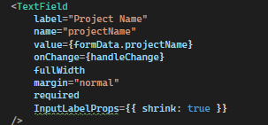
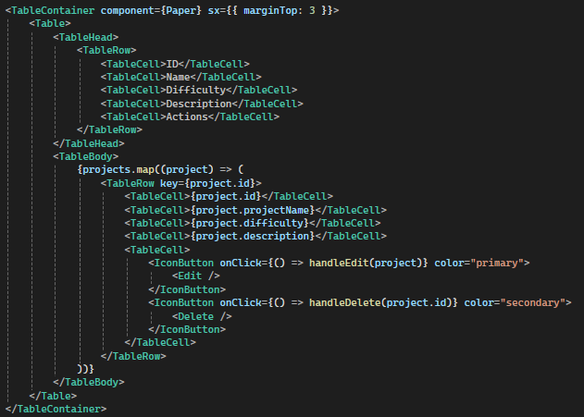
APPLICATION IN REACT
UI Components: Project Form
Uses MUI TextField components for inputs
Form allows creating & updating projects
Reset button clears form and exits edit mode
UI Components: Project Table
Displays projects in a MUI Table
Uses Edit and Delete icons for actions
Clicking Edit fills the form for modification
Clicking Delete removes the project

Slide 27
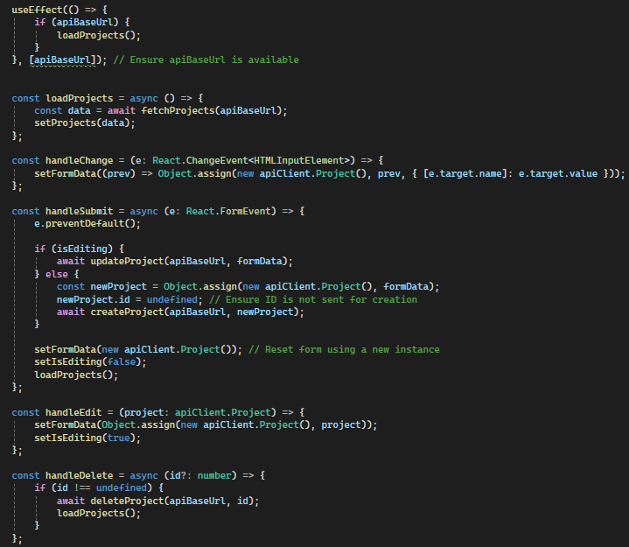
APPLICATION IN REACT
API Integration
Uses fetchProjects, createProject, updateProject, deleteProject
Calls API using apiBaseUrl
Ensures async operations for smooth user experience

Slide 28
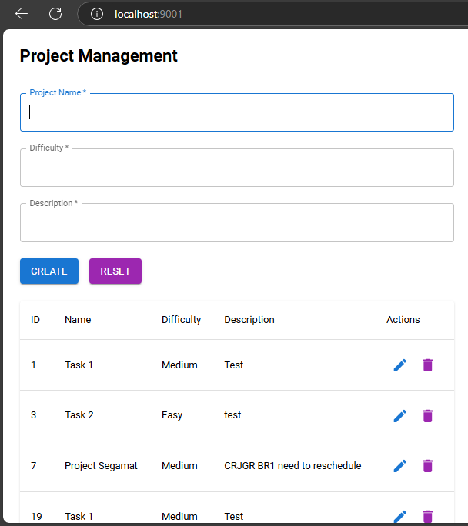
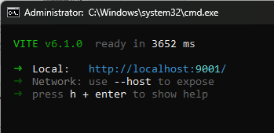
APPLICATION IN REACT
Once run the application, go to link provided in cmd.
Then, your application is ready to use.

